Slide 1

PEOPLE ANALYTICS PRESENTATION
Senior & Leadership
Attrition Analysis
Identifying risk drivers and preventive actions at Pulse Diagnostics
Pulse Diagnostics
Prepared by Leticia Mie Otani
Pulse Diagnostics | Senior & Leadership Attrition Analysis
1

Slide 2
People Analytics consultant
INTRODUCTION
How the project was structured
Leticia Mie Otani
Business framing
Defined the risk problem, business case, value realization and executive questions.
Project theme: turn prior coursework into a decision-ready retention story for leadership.
Hypotheses & research
Translated stakeholder needs into testable hypotheses and grounded the work in external research.
• Focused the analysis on senior and leadership roles where exits carry disproportionate business risk.
• Combined stakeholder input, hypothesis prioritization, quantitative analysis and insight generation.
• Designed the final output for executive decision-making rather than descriptive reporting alone.
Data analysis & insights
Prepared the dataset, tested key drivers, and converted findings into executive-ready insights.
Pulse Diagnostics | Senior & Leadership Attrition Analysis
2

Slide 3
Executive Summary
SUMMARY
What leaders should do next
Leadership attrition risk is concentrated in specific tenure and department segments — not broadly across every leadership driver available in the dataset.
Target actions where risk is concentrated
• Prioritize R&D retention diagnostics and manager-level review.
• Strengthen early-leader integration and mid-tenure mobility conversations.
• Avoid broad, untargeted fixes such as blanket travel or merit-budget changes.
• Early-tenure leaders show the highest attrition rate, while mid-tenure leaders account for the largest recent-exit volume.
• Research & Development is the clearest structural hotspot; Sales shows signs of newer, emerging risk.
• Years in role, work-life balance, salary increases, performance ratings and standard engagement measures did not materially separate leavers from non-leavers.
• The strongest action path is targeted retention in high-risk segments plus deeper data collection on mobility, promotion and exit reasons.
Evidence at a glance
74
133
~0
recent exits in the mid-tenure group
recent exits in Research & Development
engagement correlations with recent exits
Pulse Diagnostics | Senior & Leadership Attrition Analysis
3
Notes:
[Sources] - Internal findings synthesized from Insights Generation, Power BI screenshots, analyst interpretations, Data Analysis, and Business Analytics.

Slide 4
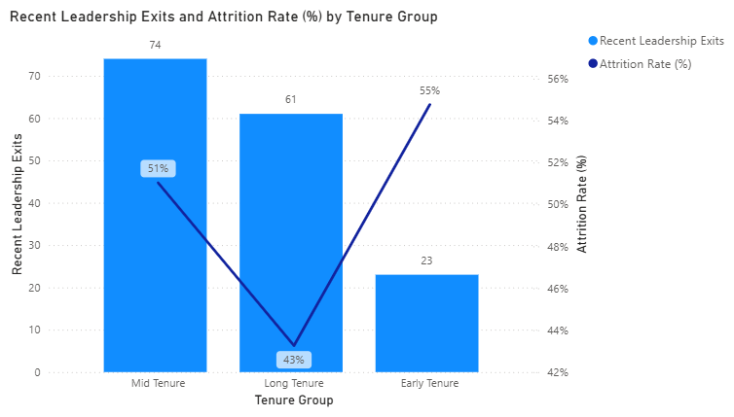
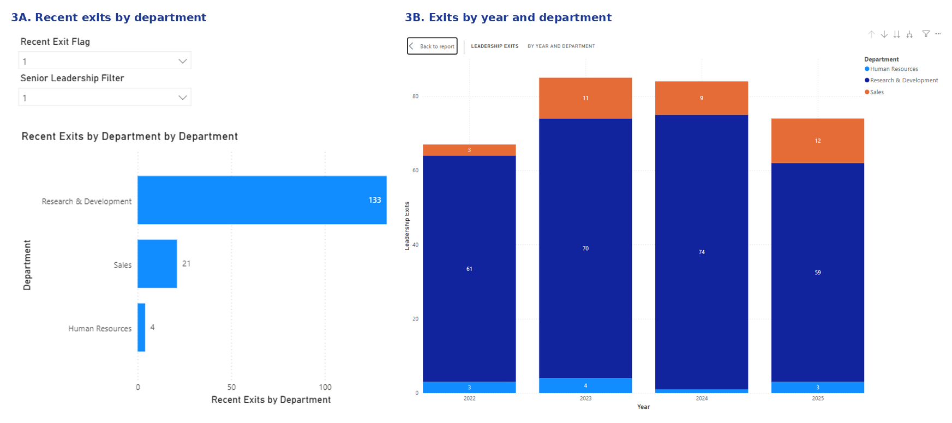
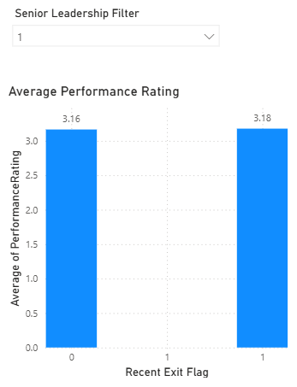
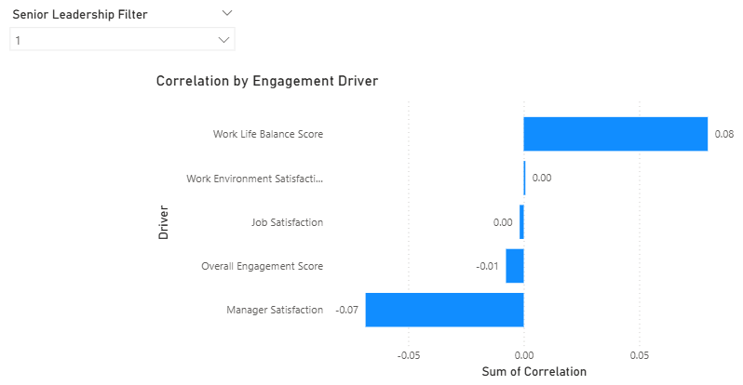
Table of Contents
ROADMAP
This presentation moves from business framing to evidence, then to targeted retention actions.
01
1. Business context and project objectives
02
2. External research and analytical approach
03
3. Key findings from the leadership attrition analysis
04
4. Deep dives on tenure, department and non-drivers
05
5. Recommended actions and appendix
Appendix includes project planning, hypothesis prioritization, data constraints and additional exhibits.
Pulse Diagnostics | Senior & Leadership Attrition Analysis
4

Slide 5
Project Background
BUSINESS CONTEXT
Why this project was needed
Why focus on leadership roles
1
Leadership exits disrupt teams, projects and client continuity.
Pulse Diagnostics had attrition reporting, but not decision-ready insight on where leadership risk was concentrated or what to do about it.
2
Replacement costs and time-to-productivity are materially higher.
3
Leadership turnover can trigger downstream attrition and succession risk.
• Leadership interviews indicated elevated concern around mid-tenure exits and pressure in Sales and R&D.
• Existing reporting was largely historical and did not connect patterns to actionable retention decisions.
• Senior and leadership roles were prioritized because exits in those roles create outsized continuity, capability and replacement-cost risk.
Current-state signal from prior work
The project was designed to answer three executive questions:
• Where is leadership attrition risk most concentrated?
• Which drivers are actually associated with exits?
• Which actions are within management control?
Pulse Diagnostics | Senior & Leadership Attrition Analysis
5

Slide 6
Project Objectives & Scope
FRAMING
Primary objectives
• Identify leadership segments with elevated attrition risk.
• Test how tenure, role characteristics, workload, engagement and organizational context relate to exits.
• Differentiate systemic drivers from localized or role-specific issues.
• Focus on insights that can inform strategic retention action rather than descriptive reporting alone.
In scope
Out of scope
Success criteria
• Senior and leadership roles
• Voluntary attrition patterns and risk indicators
• Drivers that can inform action
• Broad engagement diagnostics
• Individual performance evaluation
• Design of full retention programs
• Clear prioritization of at-risk leadership segments
• Evidence-based view of what is and is not driving attrition
• A practical agenda for targeted retention decisions
Pulse Diagnostics | Senior & Leadership Attrition Analysis
6

Slide 7
External Research & Industry Insights
RESEARCH
External research validated why leadership attrition should be treated as a focused business-risk problem.
70%
0.5–2×
Contagion
Managers shape engagement
Turnover is expensive
Exits can spread
Gallup estimates managers account for at least 70% of the variance in team engagement, reinforcing why leader quality matters for downstream retention.
Gallup and Bersin-cited turnover research place replacement cost at roughly one-half to two times salary, with senior roles often higher.
Turnover-contagion research shows employees can imitate turnover-related attitudes and behaviors of coworkers, meaning one exit can trigger more loss.
Implication for Pulse Diagnostics: senior-leader exits create disproportionate cost, continuity and cultural risk, so targeted retention analysis is strategically justified.
Pulse Diagnostics | Senior & Leadership Attrition Analysis
7
Notes:
[Sources] - Gallup, “Managers Account for 70% of Variance in Employee Engagement” (2015): https://news.gallup.com/businessjournal/182792/managers-account-variance-employee-engagement.aspx - Gallup, “This Fixable Problem Costs U.S. Businesses $1 Trillion” (2019): https://www.gallup.com/workplace/247391/fixable-problem-costs-businesses-trillion.aspx - Qualtrics, “Calculating the Cost of Employee Turnover” (2023), citing Josh Bersin: https://www.qualtrics.com/articles/employee-experience/cost-of-employee-turnover/ - Porter et al., “The turnover contagion process: An integrative review of theory and research” (2021): https://onlinelibrary.wiley.com/doi/abs/10.1002/job.2483

Slide 8
Overview of the Data Analysis Approach
METHOD
The analysis combined HRIS and engagement data, then tested prioritized hypotheses using transparent Excel-based methods.
1. Define the cohort
2. Prepare the dataset
3. Segment and test
4. Interpret and validate
Filtered the dataset to senior and leadership roles and created a recent-exit indicator for 2024–2025.
Cleaned fields, standardized scales, grouped tenure and requested missing exit and job-title information.
Used pivot tables, descriptive comparisons, chi-square tests, t-tests and correlations.
Compared patterns across tenure, department and engagement variables, then translated results for decision-makers.
Key inputs and derived fields
Important constraints
• Core variables: tenure, years in role, department, leadership level, travel, work-life balance, job satisfaction, performance and salary increase.
• Derived variables: tenure stage, attrition indicator, leadership filter, recent-exit flag and overall engagement score.
• The initial dataset lacked exit dates and reasons; these had to be requested and enriched.
• Available HR variables explain where risk sits, but likely do not capture mobility, promotion or external labor-market pull.
Pulse Diagnostics | Senior & Leadership Attrition Analysis
8
Notes:
[Sources] - Internal source: Data Analysis, including data attributes, wrangling approach, transformations, statistical methods, assumptions and constraints.

Slide 9
Summary of Key Insights
FINDINGS
Across the analysis, risk clustered around tenure stage and department more clearly than around standard engagement, pay or performance variables.
• Tenure matters, but in two different ways: early tenure shows the highest attrition rate, while mid-tenure holds the largest exit volume.
• Research & Development is the main structural hotspot for recent leadership exits.
• Sales appears to be a smaller but newer risk pocket that should be monitored before it grows.
• Years in role, work-life balance, salary increases and performance ratings show only minimal differences between leavers and non-leavers.
• The current dataset points to likely missing drivers such as promotion timing, internal mobility, exit reasons and external market pull.
Pulse Diagnostics | Senior & Leadership Attrition Analysis
9

Slide 10
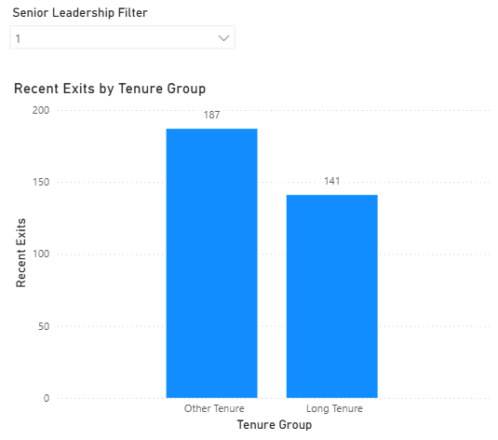
Deep Dive: Tenure Dynamics
INSIGHT 1
Tenure patterns suggest two different retention needs: leader integration at the start, and career-path support in the middle of the leadership journey.
Interpretation: retention action should not focus on a single tenure trigger. Early-tenure leaders need stronger integration and support, while mid-tenure leaders need clear mobility, recognition and growth pathways.
Key evidence: mid-tenure recorded 74 recent exits; long tenure recorded 141 exits versus 187 across all other tenure stages combined.
Pulse Diagnostics | Senior & Leadership Attrition Analysis
10
Notes:
[Sources] - Internal visuals: tenure-group Power BI screenshots - Internal interpretation informed by analyst write-ups

Slide 11
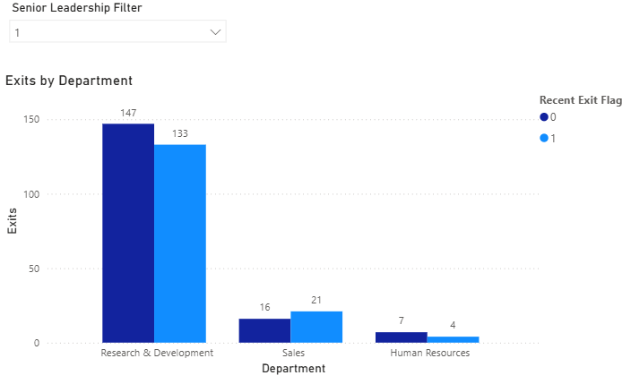
Deep Dive: Department Concentration
INSIGHT 2
Department risk is not evenly distributed. The evidence points to one chronic hotspot and one smaller emerging one.
R&D is the chronic hotspot
Sales shows newer risk
HR remains low-risk in this dataset
Pulse Diagnostics | Senior & Leadership Attrition Analysis
11
Notes:
[Sources] - Internal visuals: department attrition Power BI screenshots. - Internal interpretation informed by analyst write-ups.

Slide 12
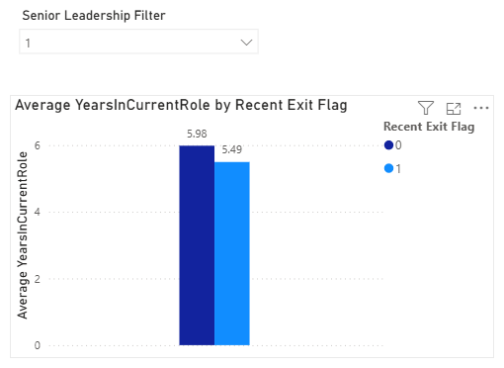
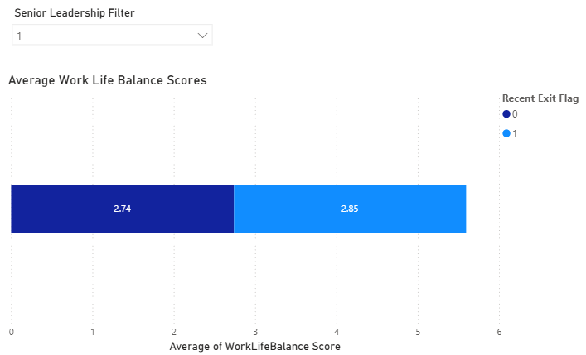
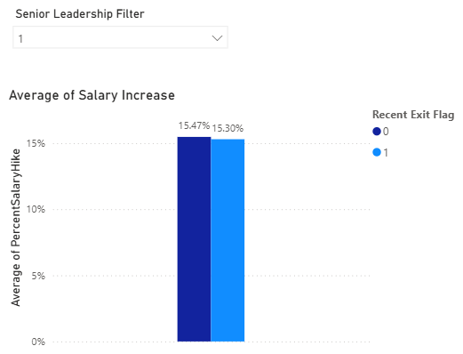
Deep Dive: What Is Not Driving Exits
INSIGHT 3
Several commonly assumed drivers show almost no separation between leaders who exited recently and those who did not.
What the numbers suggest
Implication
• Average years in role are nearly identical: 5.56 vs. 5.49 years.
• Work-life balance is also nearly unchanged: 2.74 vs. 2.85.
• Salary increase percentages are almost the same: 15.47% vs. 15.30%.
• Performance ratings differ by only 0.02 points: 3.16 vs. 3.18.
The current HR variables help rule out some default explanations, but they do not reveal the true mechanism behind exits. The next layer of analysis should focus on promotion velocity, internal mobility, manager context, exit reasons and external market pull.
Pulse Diagnostics | Senior & Leadership Attrition Analysis
12
Notes:
[Sources] - Internal visuals: Power BI screenshots for years in role, work-life balance, salary increase and performance rating.

Slide 13
Recommended Actions & Next Steps
ACTION
The evidence supports targeted interventions now, paired with sharper data collection for the next decision cycle.
Act now
Do not overreact to weak signals
Build the next evidence layer
• Launch an R&D leadership retention diagnostic with HRBPs and functional leaders.
• Add structured 6-, 12- and 24-month checkpoints for early-tenure leaders.
• Review mid-tenure leader movement, recognition and development opportunities.
• Do not treat travel policy as the primary fix.
• Do not assume generic work-life initiatives will solve the leadership issue.
• Do not deploy broad merit-budget increases without stronger evidence of pay-driven risk.
• Separate voluntary and involuntary exits consistently.
• Track promotion timing, internal moves and succession readiness.
• Integrate exit-interview themes and external labor-market indicators.
Pulse Diagnostics | Senior & Leadership Attrition Analysis
13
Notes:
[Sources] - Internal recommendations inferred from the Business Case, Insights Generation, and Data Analysis findings. - External rationale on turnover cost and manager influence summarized earlier in Slide 7 notes.

Slide 14
Appendix
Additional planning, methodology and supporting exhibits
Pulse Diagnostics | Senior & Leadership Attrition Analysis
14

Slide 15
Appendix: Project Timeline & Governance
APPENDIX
Original project plan was designed as an 8-week people-analytics engagement with milestone reviews at the end of Weeks 1, 5 and 8.
Phase
W1
W2
W3
W4
W5
W6
W7
W8
Project initiation & scope approval
Data access & validation
Attrition analysis & hypothesis testing
Insight synthesis & HR validation
Executive reporting
Governance cadence
Key dependencies
Kickoff W1 | Data readiness W3 | Interim findings W5 | Validation W6–7 | Final presentation W8
HRIS access, updated exit data, HRBP validation and aligned executive review cycles.
Pulse Diagnostics | Senior & Leadership Attrition Analysis
15
Notes:
[Sources] - Internal source: Project Plan, including timeline, milestones, activities, dependencies, roles and governance cadence.

Slide 16
Appendix: Hypothesis Prioritization
APPENDIX
The project started with 20 hypotheses that got prioritized to a top 10 set based on strategic priority, actionability, data availability and analytical complexity.
Scoring logic
1. Attrition risk by tenure stage
6. Travel requirements and senior exits
• Strategic priority
• Actionability
• Data availability
• Analytical complexity (tracked separately)
2. Long-tenure leadership risk
7. Work-life balance as a predictor of exits
3. Ranked attrition risk by department
8. Engagement drivers linked to attrition
Highest-value user stories prioritized analysis on tenure, department, time in role, travel, work-life balance, engagement, salary increase and performance.
4. Years in role as a risk flag
9. Salary increase linked to exit risk
5. Sales and R&D risk versus other departments
10. Performance ratings linked to exits
Pulse Diagnostics | Senior & Leadership Attrition Analysis
16
Notes:
[Sources] - Internal source: Hypothesis Explanation and Inventory document, including scoring framework, 20 hypotheses and top 10 prioritized user stories.

Slide 17
Appendix: Data Model, Transformations & Constraints
APPENDIX
Core data attributes
Key transformations
Constraints to remember
• Tenure and years in role
• Department and job role
• Leadership level / filter
• Travel requirement
• Engagement indicators
• Performance rating and salary increase
• Created tenure-stage groups
• Built attrition indicator
• Created leadership filter
• Added recent-exit flag for 2024–2025
• Calculated overall engagement average
• Initial dataset lacked exit dates and reasons
• Job titles required correction for some leadership roles
• Available variables may miss promotion, mobility and external-pull drivers
• Excel-based methods prioritize interpretability over complex modeling
Pulse Diagnostics | Senior & Leadership Attrition Analysis
17
Notes:
[Sources] - Internal source: Data Analysis Assignment, including variables received, assumptions, wrangling phases, formulas and method limitations.

Slide 18
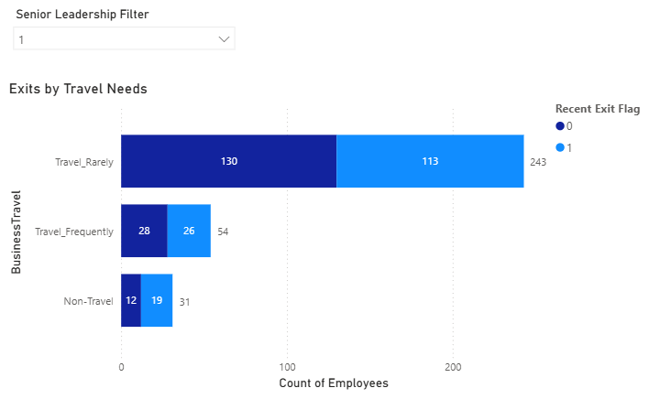
Appendix: Additional Exhibits — Travel & Engagement
APPENDIX
Two supporting exhibits further reinforced that broad travel or survey-based interventions alone are unlikely to solve the leadership attrition problem.
Travel requirements did not display a disproportionate recent-exit pattern.
Engagement correlations clustered around zero, indicating weak explanatory power.
Pulse Diagnostics | Senior & Leadership Attrition Analysis
18
Notes:
[Sources] - Internal visuals: travel-needs and engagement-correlation Power BI screenshots.

Slide 19
Appendix: Additional Exhibits — Compensation & Performance
APPENDIX
Compensation and performance variables were also weak differentiators, suggesting the organization may be losing capable leaders for reasons outside the standard HR fields available.
≈
Neither metric materially distinguished recent leavers from the comparison group.
Pulse Diagnostics | Senior & Leadership Attrition Analysis
19
Notes:
[Sources] - Internal visuals: salary-increase and performance-rating Power BI screenshots.

